Slide 1

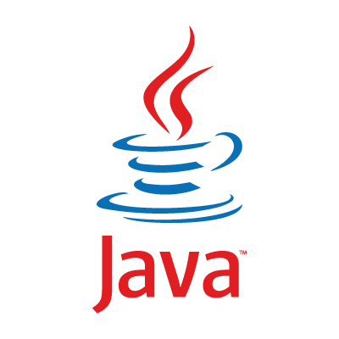
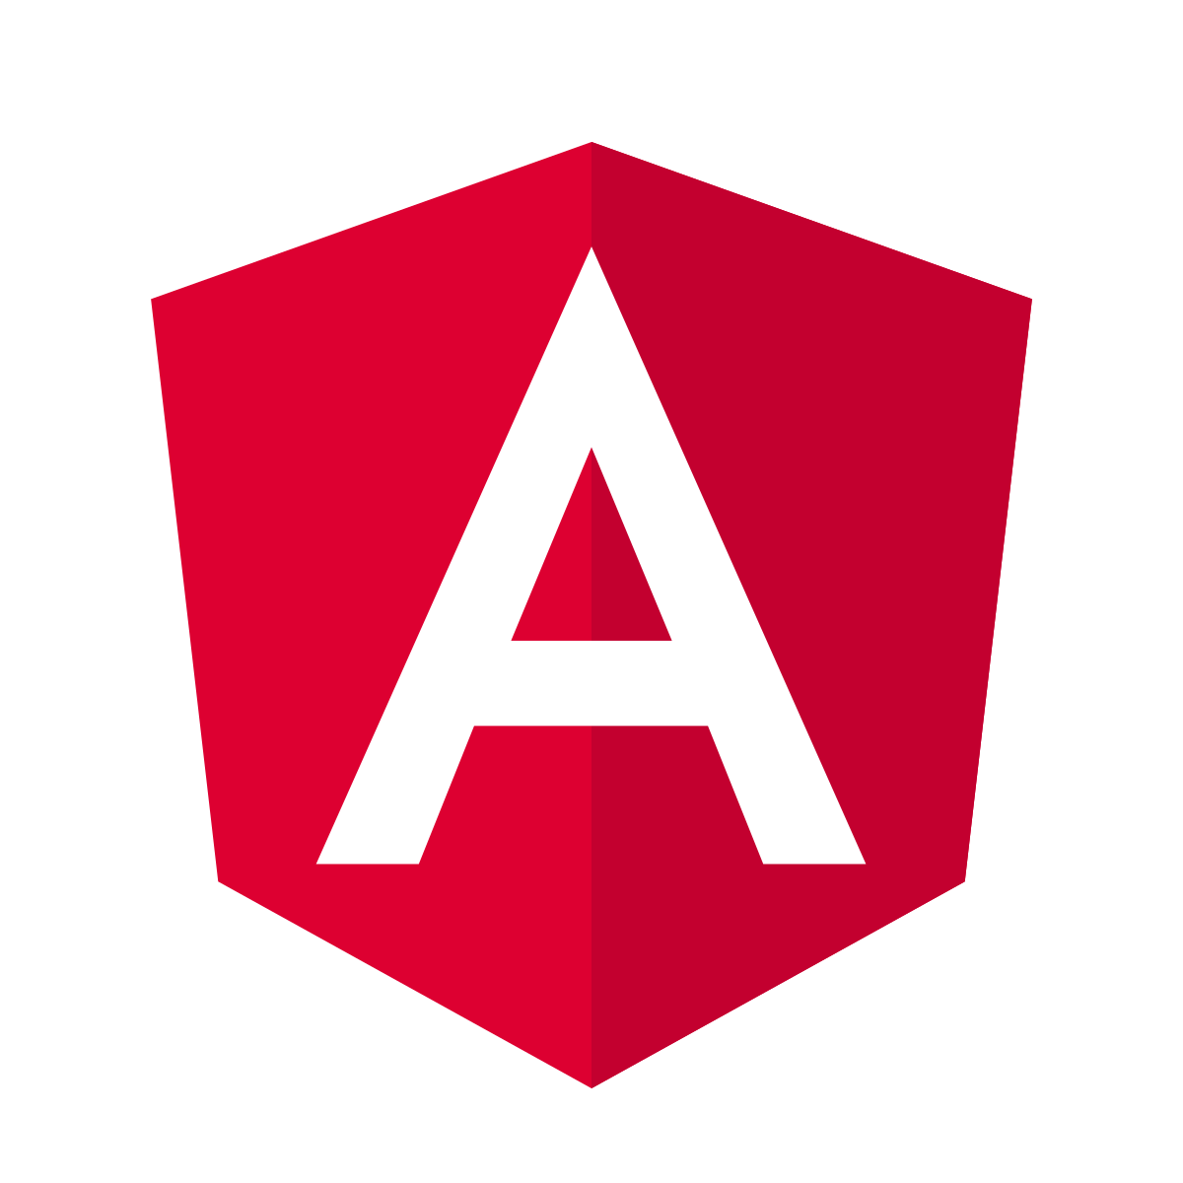
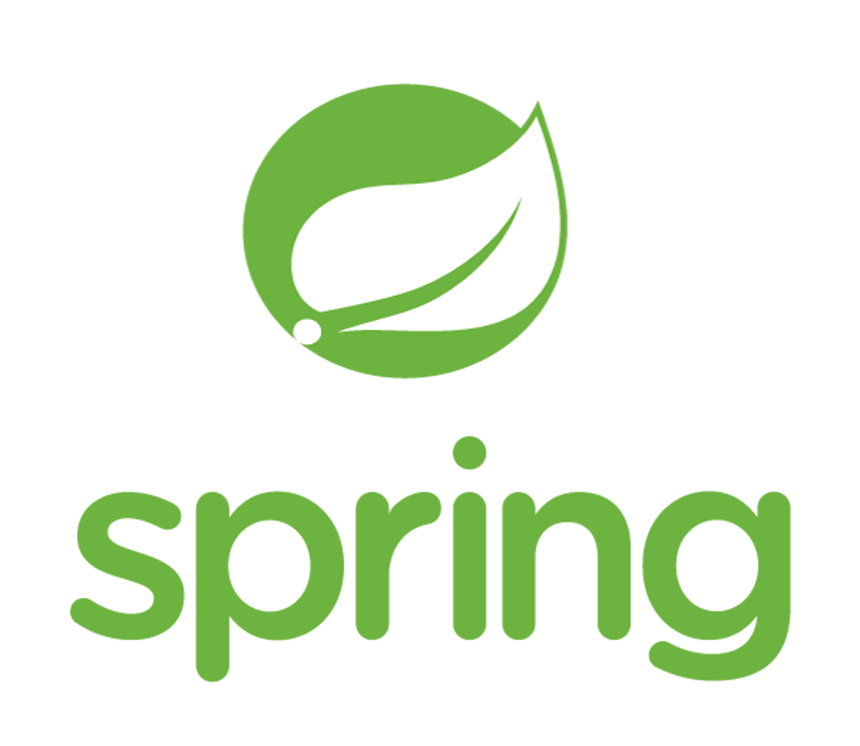


Full Stack Java Developer.

Slide 2
About Your Instructor
Java Developer Lead Instructor: Carlos Zegarra
Twelve years of work experience with Java and Java frameworks.
Seven years of teaching Java and Java frameworks.
My goal as your instructor, more than teaching, is to share my knowledge and experience to motivate and inspire you to move forward in your IT career.
There is no such thing as a silly question. Everybody is learning in class; even your instructor learns new stuff from you, so please don’t be shy.
FULL STACK JAVA DEVELOPER TRAINING www.busyqa.com/bigdata | www.busyqa.com/online-automation

Slide 3
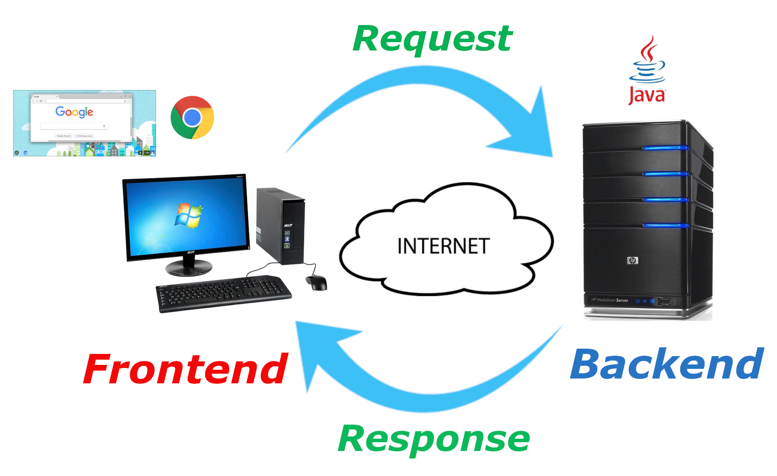

About the Goal of the Course
Become a Full-Stack Java Developer
Frontend Team
Backend Team
FULL STACK JAVA DEVELOPER TRAINING www.busyqa.com/bigdata | www.busyqa.com/online-automation
Notes:
Software Stack - A software stack is a group of programs that work in tandem to produce a result or achieve a common goal.

Slide 4
What will you learn?
1. Course part:
Week 1 – 4 : Java Programming Language (Java Syntax, OOP, Java Libraries).
Week 5 – 8 : Spring Framework (It is a Java framework for Backend Applications)
Week 9 – 12 : Angular Framework (It is a JavaScript framework for Frontend Applications)
Week 13 : Spring + Angular Integration (Deployment of the frontend and backend on Amazon AWS, and CI/CD with Jenkins)
Week 14 : DevOps Tools (Tools that speed up the deployment process)
2. Coop part:
3 months: You will put into practice all the things learned during the course.
FULL STACK JAVA DEVELOPER TRAINING www.busyqa.com/bigdata | www.busyqa.com/online-automation

Slide 5

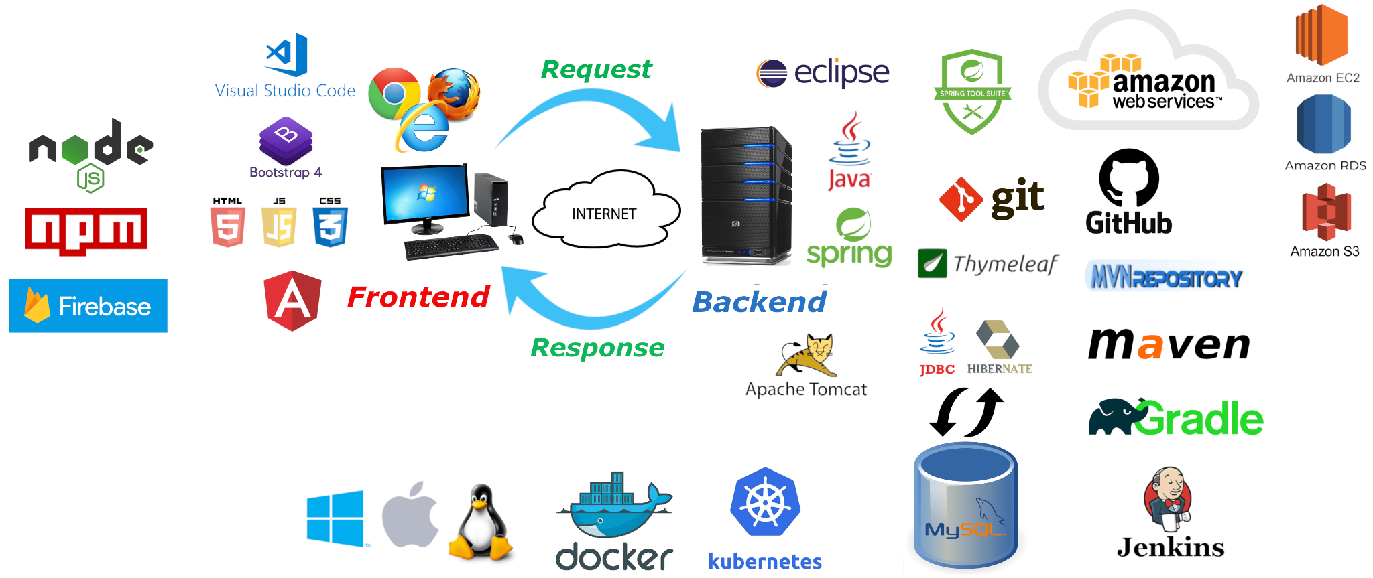
What will you learn?
FULL STACK JAVA DEVELOPER TRAINING www.busyqa.com/bigdata | www.busyqa.com/online-automation
Notes:
The CI/CD pipeline phases
From source code to production, these phases make up the development lifecycle and workflow of the CI/CD pipeline:
Build: This phase is part of the continuous integration process and involves the creation and compiling of code. Teams build off of source code collaboratively and integrate new code while quickly determining any issues or conflicts.
Test: At this stage, teams test the code. Automated tests happen in both continuous delivery and deployment. These tests could include integration tests, unit tests, and regression tests.
Deliver: Here, an approved codebase is sent to a production environment. This stage is automated in continuous deployment and is only automated in continuous delivery after developer approval.
Deploy: Lastly, the changes are deployed and the final product moves into production. In continuous delivery, products or code are sent to repositories and then moved into production or deployment by human approval. In continuous deployment, this step is automated.

Slide 6
Thank you for joining us!
FULL STACK JAVA DEVELOPER TRAINING www.busyqa.com/bigdata | www.busyqa.com/online-automation

